Slide 1
Wine Quality Prediction Using Machine Learning
Multivariate Statistical Methods for Big Data Analysis and Process Improvement (SEP 767 )
Guided By Prof. : Dr. Brandon Corbett
Name: Henis Sureshkumar Nakrani
Student Id: 400547270

Slide 2
Introduction
The complexity and variety of wine's headspace make wine discrimination a difficult process. The reason wine classification matters so much is for different reasons.
These include the wine products' economic value, the need to protect and ensure wine quality, the prohibition of wine adulteration, and the need to regulate beverage processing.
Study of red(1599 Samples) and white(4898 Samples) two different types of Portuguese "Vinho Verde" wine.
When dealing with a wine, it is of interest to be able to predict its quality based on chemical and sensory variables.
The result was a categorical variable since the wine's quality was evaluated by experienced judges using a 0–10 scale, where 0 represented very poor quality and 10 represented excellent quality.
Challenges: Absence of data about grape types, brand, selling price, etc.
The role of PCA in visualization and dimensionality reduction and accuracy varying according components.
I used this research paper to examine the issue and evaluate how the Principal Component Analysis (PCA) components influence the model's performance. Link

Slide 3
Database Description and Objective
The dataset that has been used for examining the effects of the chemical properties of wine on its physical properties has been taken from Kaggle (https://www.kaggle.com/datasets/uciml/red-wine-quality-cortez-et-al-2009).
The datasheet contains 1599 observations. Each observation has 12 Features.
The variables are fixed acidity, volatile acidity, citric acid, residual sugar, chlorides, free sulfur dioxide, total sulfur dioxide, density, pH, sulphates, alcohol and based on sensory data quality (score between 0 and 10).
Quality > 5.5 => “good”,
TRUE => “bad”
The objectives of this project is to find out how the physical and chemical characteristics of a wine related to its overall quality.
Predict the wine quality by applying ANN(Artificial Neural Network), K Nearest Neighbor, Linear Discriminant Analysis before and after applying the PCA.

Slide 4
Methodology
Data Preparation & Exploration
Data cleaning (Rename, Pair plot, Remove Outliers, Mean centering and scaling ), Feature Selection (PCA), Data Splitting
Dimensionality Reduction
Apply PCA to the standardized dataset to derive principal components. Reducing feature space.
Model Building & Performance Evaluation
Train machine learning models SVM, LDA, KNN, ANN on both the original standardized dataset and the PCA-transformed dataset and analyze the training, testing accuracy and computational time and confusion matrices and Cross-Validation.
Interpretation & Conclusion
Identify the significance of each percentage of correctly classified instances, precision, recall, F measure on original standardized dataset and the PCA-transformed dataset.

Slide 5
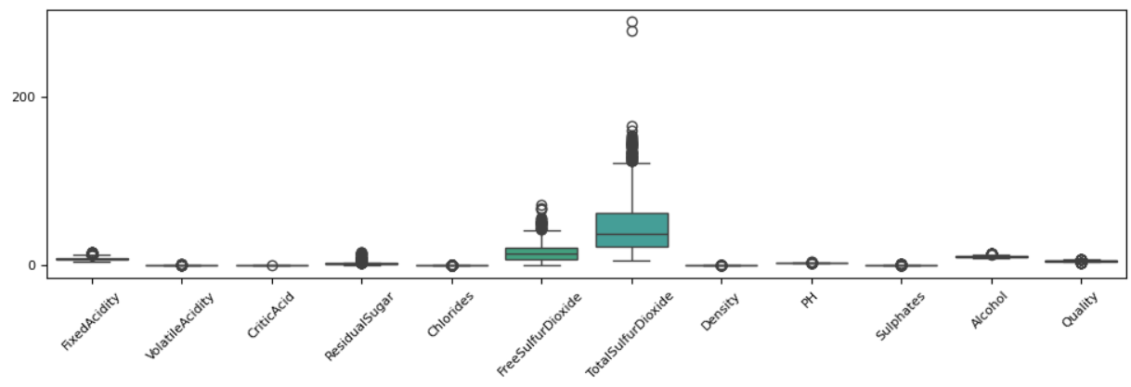
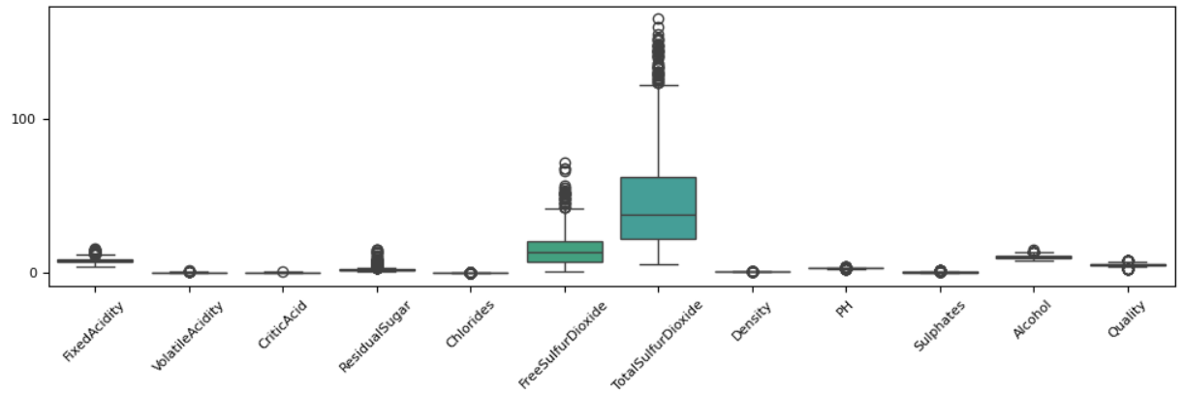
Data Preparation and Exploration
Removed Outliers from Total Sulfur Dioxide

Slide 6
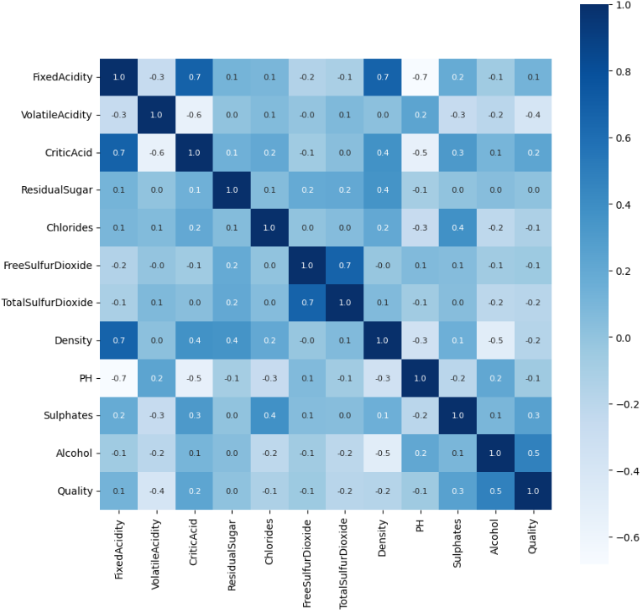
Correlation Matrix

Slide 7
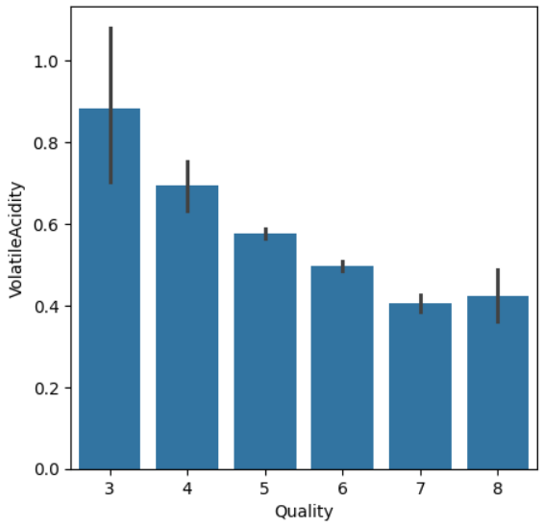
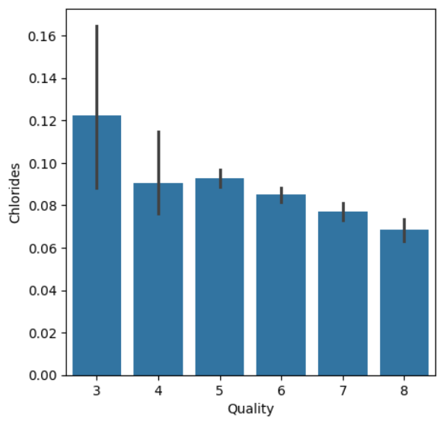
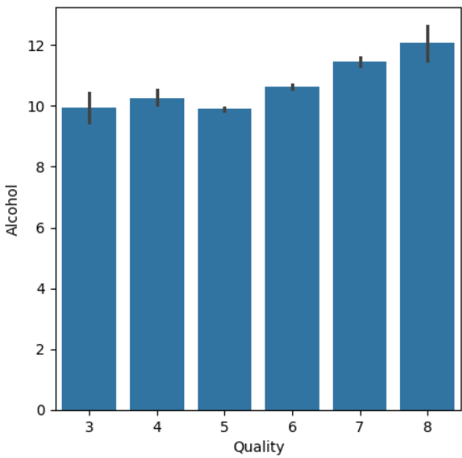
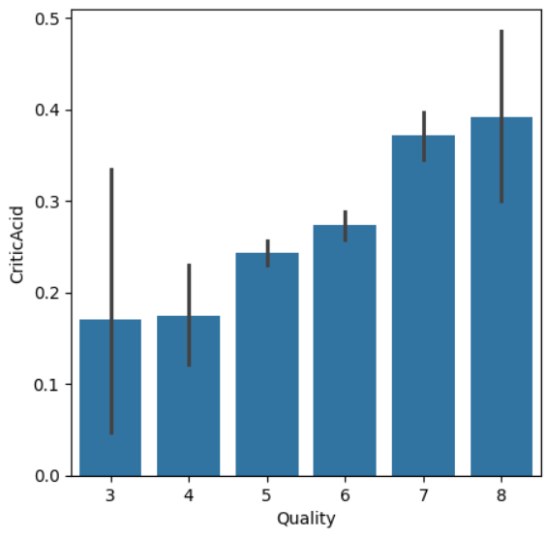
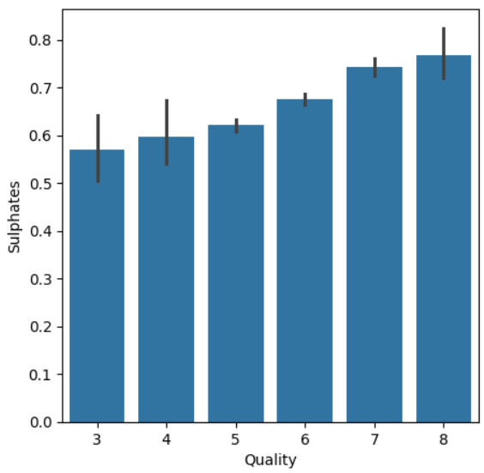
Relation of other variables With Quality

Slide 8
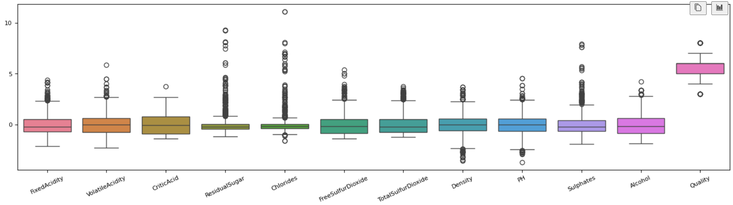
Mean Centered and Scaled Data

Slide 9
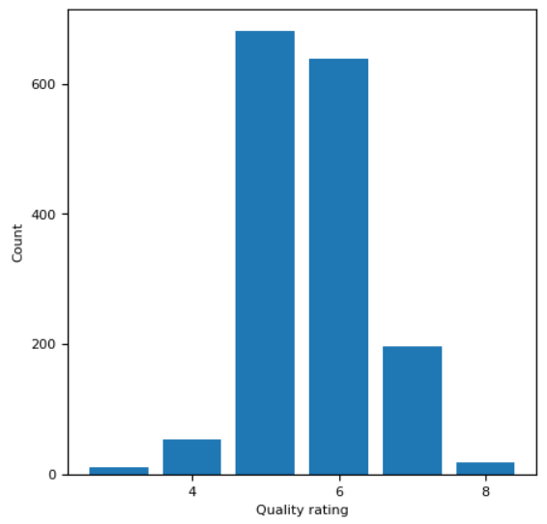
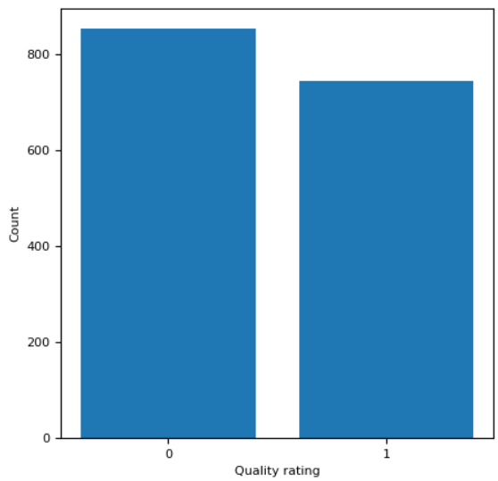
Quality Distribution

Slide 10
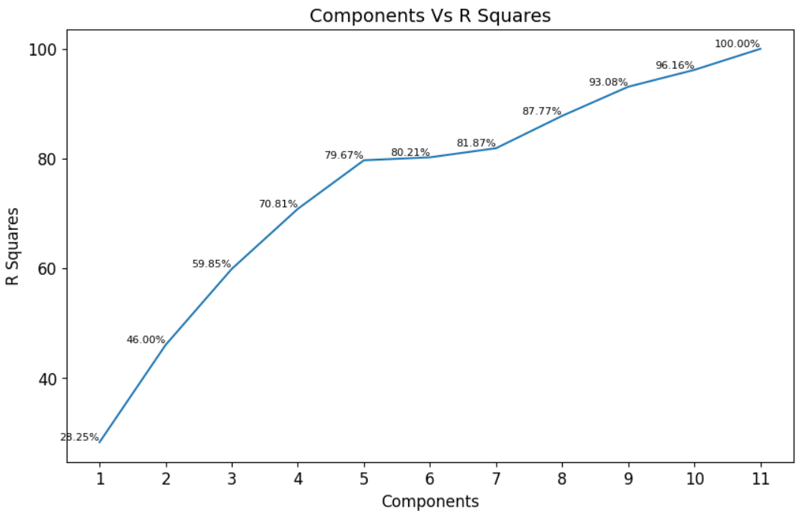
PCA
According to the graph, when we apply PCA to our dataset, we can explain approximately 80% of the data by using 5 components for our dataset.

Slide 11
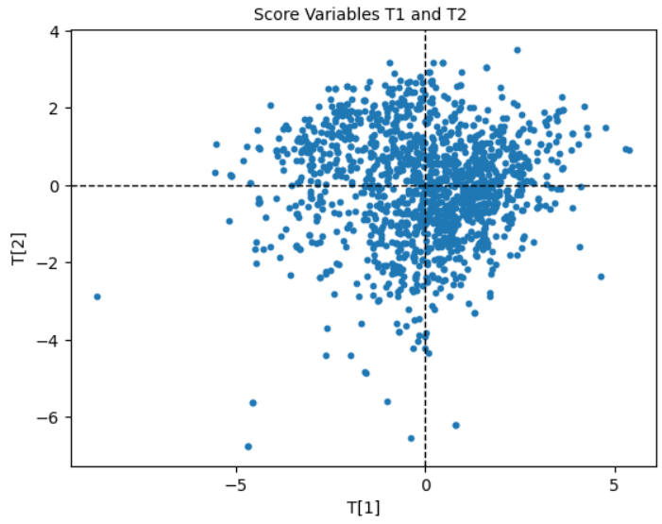
Score Biplot
Scores T[1] and T[2]

Slide 12
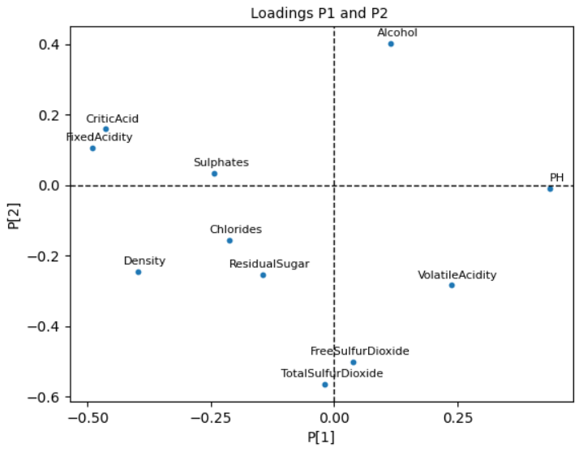
Loading Biplot
Loadings p1 and p2

Slide 13
Models
 | Accuracy (%) | Precision (%) | Recall (%) | F1-Score (%)
SVM | 78.50 | 85.41 | 72.81 | 78.61
LDA | 75.75 | 75.12 | 77 | 76.05
KNN | 37.75 | 39.48 | 46 | 42.49
Binary Class ANN | 74 | 76.25 | 79.02 | 75.70
Multi Class ANN | 60.50 | 59.50 | 60.50 | 59.84

Slide 14
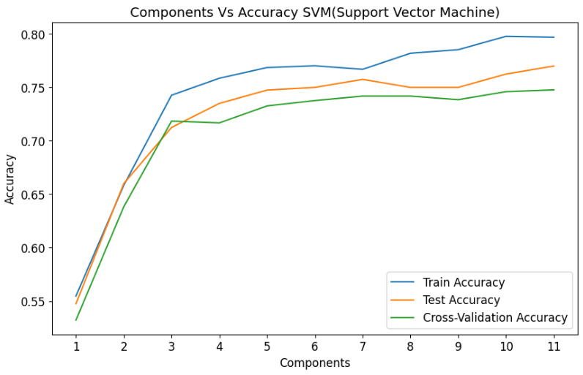
PCA with SVM
Without PCA | Accuracy (%) | Precision (%) | Recall (%) | F1-Score (%) | Cross Validation Ac.
SVM | 78.50 | 85.41 | 72.81 | 78.61 | 75.43

Slide 15
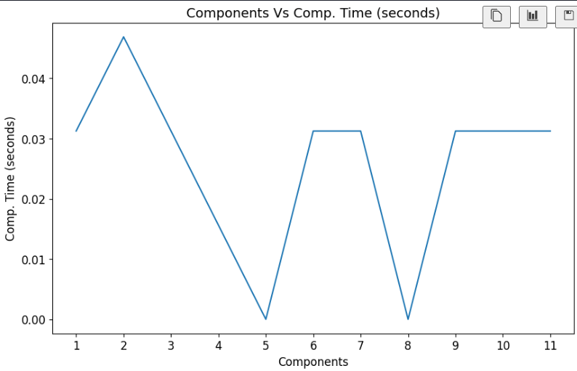
Computational Time With PCA for each Components in SVM

Slide 16
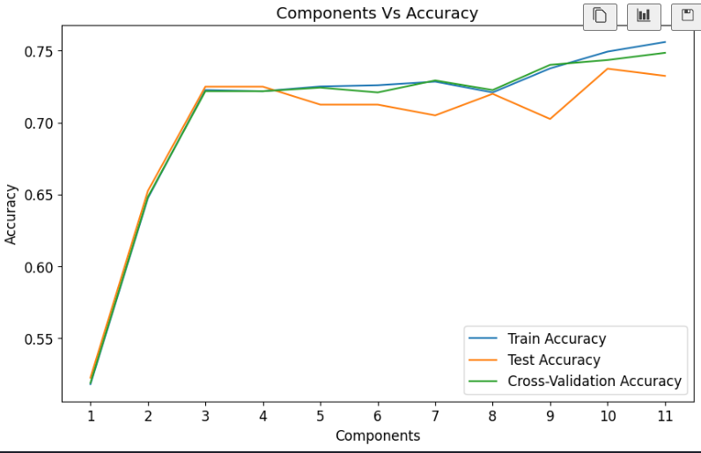
PCA with LDA ( Linear Discriminant Analysis )
Without PCA | Accuracy (%) | Precision (%) | Recall (%) | F1-Score (%) | Cross Validation Ac.
LDA | 75.75 | 75.12 | 77 | 76.05 | 73.51

Slide 17
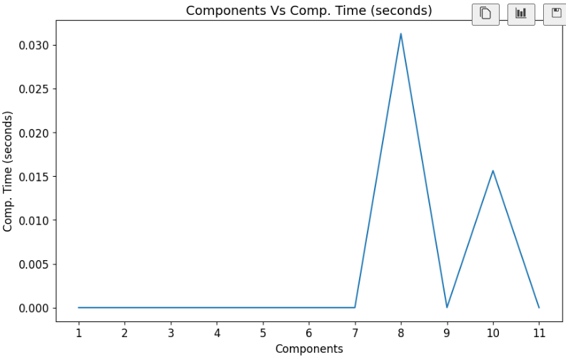
Computational Time With PCA for each Components in LDA

Slide 18
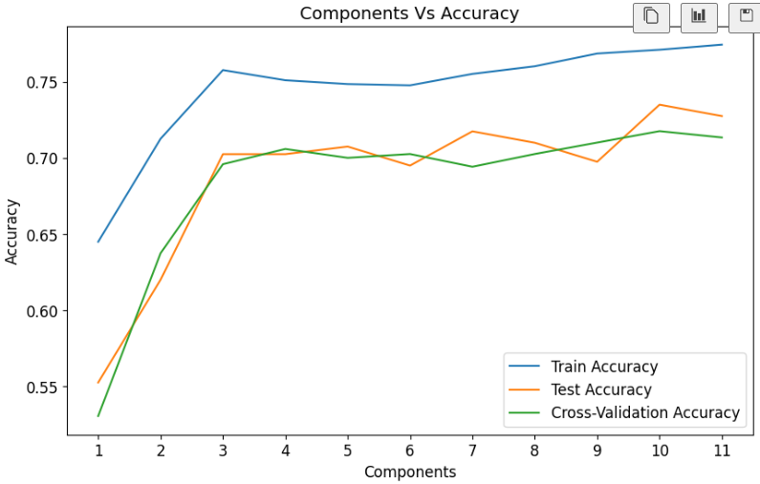
PCA with KNN( K Nearest Neighbour) (Size = 10 )
Without PCA | Accuracy (%) | Precision (%) | Recall (%) | F1-Score (%) | Cross Validation Ac.
KNN | 37.75 | 39.48 | 46 | 42.49 | 70.67

Slide 19
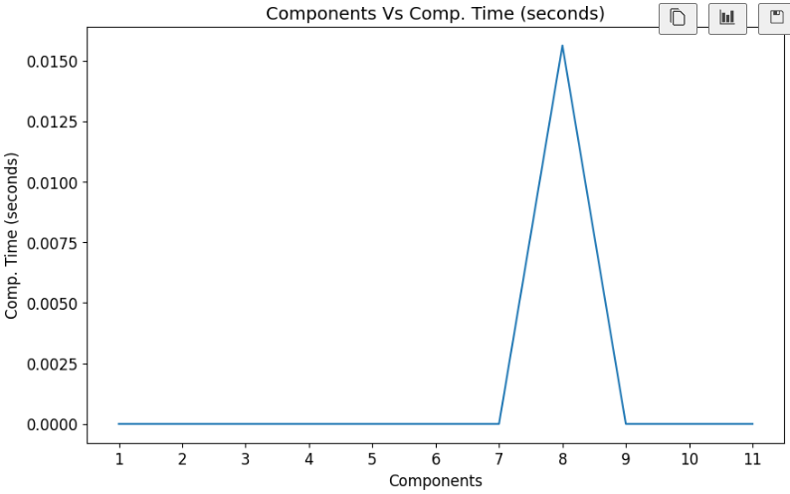
Computational Time With PCA for each Components in KNN

Slide 20
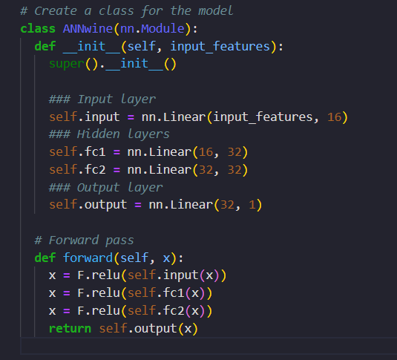
ANN Class Model

Slide 21
Hyperparameters
Learning rate : 0.01
Epochs : 2000
Batch Size : 32
Activation Function: Relu
Loss Function: BCE With Logits Loss
Optimizer: Stochastic Gradient Descent

Slide 22
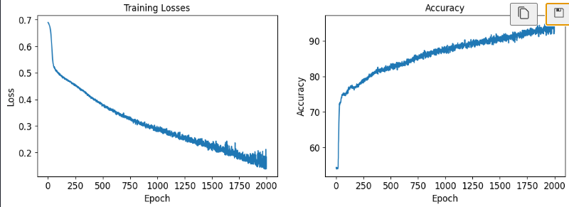

ANN

Slide 23
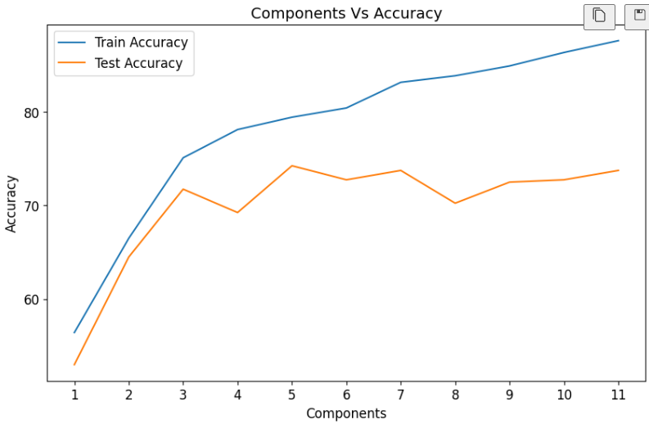
ANN with PCA

Slide 24
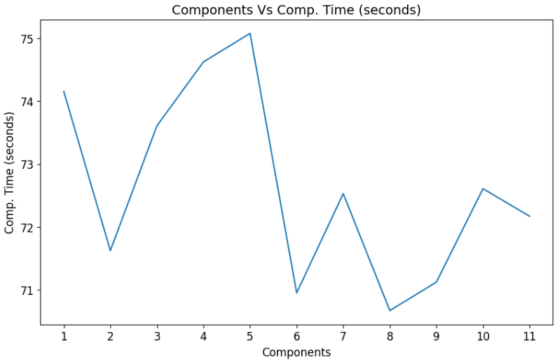
Computational Time With PCA for each Components in ANN

Slide 25
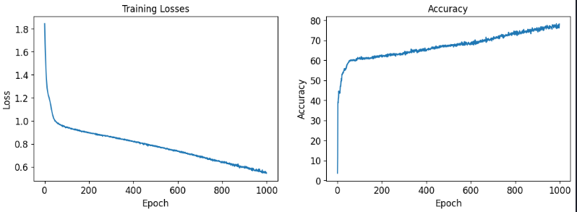

ANN With 6 Class Classification

Slide 26
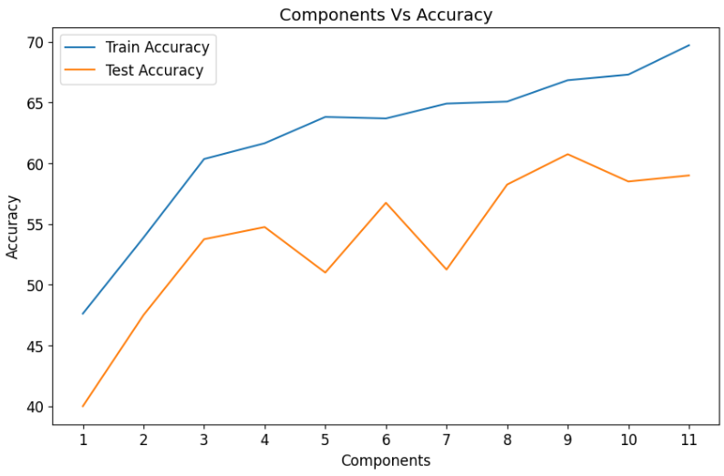
ANN Multi Class with PCA

Slide 27
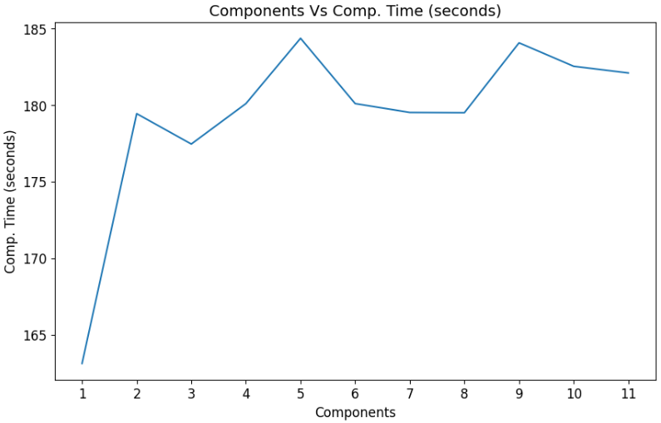
Computational Time With PCA for each Components in ANN Multi Class

Slide 28
Conclusion
For each classification model, we analyzed how the results cross-validation accuracy vary whenever principal components are changed.
The study includes the analysis of classifiers on red wine data set. The results are described in percentage of correctly classified instances, precision, recall, F measure.
In SVM, With 5 principal components we get a good cross validation accuracy score and least computational training time. After applying PCA, We got the cross-validation accuracy from 77 % to 75 % with 5 scores.
In LDA, With 3 principal components we get a good cross validation accuracy score and less training time. After applying PCA, We got the cross-validation accuracy from 75 % to 73 % with only 3 scores.
KNN is not good with this dataset. Overall Cross validation and training time is good with 3 principal components. After applying PCA, We got the cross-validation accuracy from 70 % to 67 % with only 3 scores.
ANN Model with binary classification 74 % testing accuracy. When we apply PCA and check the Accuracy is increased to 75 %.
Using four to five components results in satisfactory training and testing accuracies during cross-validation with LDA and ANN.
Results from the experiments lead us to conclude that Linear Discriminant Analysis and ANN performs better in classification task as compared against the support vector machine, and k-nearest neighborhood.

